Slide 1
Window Programming (1)
Introduction
Yuan Ze University

Slide 2
Window Programming 1-1
Course Introduction

Slide 3
Objectives
Understand the concept and principle of Window Programs
Be able to write Window Application Programs
  .NET
  Visual Studio 2019
    C#

Slide 4
Scoring
Program assignment 12
Quiz & practice 8
Mid-Exam 40
Final-Exam 40

Slide 5


Reference Textbook
Visual C# 2013視窗程式設計
  作者：黃聰明
  松崗出版
跟著範例學會Visual C# 2015
  作者：張逸中
  博碩出版

Slide 6


Reference Textbook
Visual C# 2012 視窗程式設計入門：繪圖與遊戲專題
  作者：鄞永傳
  松崗出版
王者歸來-C#完全開發範例集
  作者：王小科、王軍
  佳魁資訊

Slide 7
Window Programming 1-1
Introduction of window programming

Slide 8
Window Programs
Graphic User Interface (GUI)
  Window Operation Systems (視窗作業系統)
    Window 98, Window XP, Vista, Window 7, Window 8, Window 10, Mac OS
  Window Application Programs (視窗應用程式)
    Microsoft Word, Excel …
Apple, Microsoft Windows

Slide 9
Concept of Window Programming
DOS: flow based programming
Window: Event-driven (事件導向)
  Events (事件)
    Click buttons, click menu…
  Messages (訊息)
    When events occur, program receives corresponding messages

Slide 10
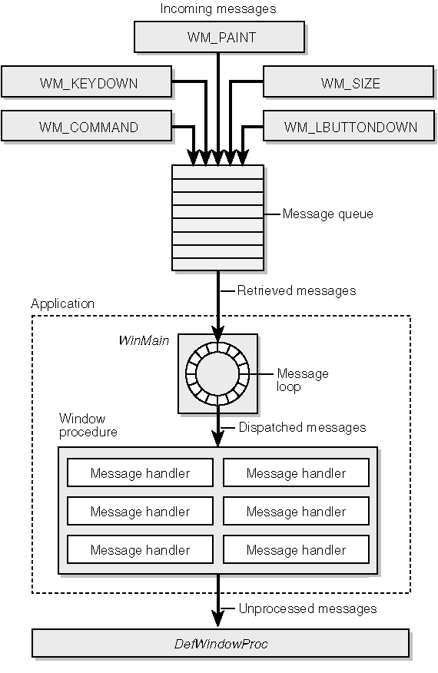
Concept of Window Programming

Slide 11
Concept of Window Programming
Assign the mapping of message and message handler
Write message handler

Slide 12
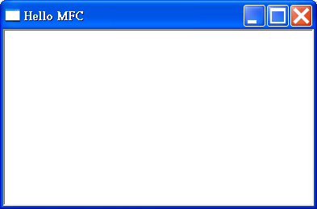
Component of Window Interface
Window
Framework
(視窗框架)
Client
(客戶區)

Slide 13
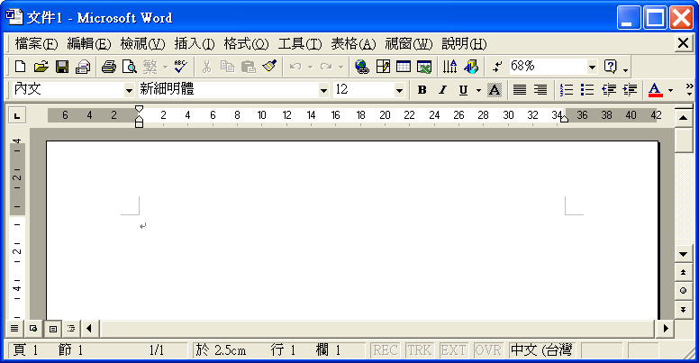
Component of Window Interface
Window Interface of Word
Menus
功能表(選單)
Toolbox
(工具列)
Client
(客戶區)

Slide 14
Reviews
What is Window Operating System? Give an example.
What is Window Application Program? Give an example.
What is event in Window Programming? What is message in Window Programming? What is message handler in Window Programming?

Slide 15
Window Programming 1-1
How to write a window application program

Slide 16
Method 1 - Win32 API
Win32 API (Application Programming Interface)
  SDK
  C

Slide 17
#include <windows.h>
LONG WINAPI WndProc (HWND, UINT, WPARAM, LPARAM);
int WINAPI WinMain (HINSTANCE hInstance, HINSTANCE hPrevInstance,
LPSTR lpszCmdLine, int nCmdShow)
{ WNDCLASS wc;
HWND hwnd;
MSG msg;
wc.style = 0; // Class style
wc.lpfnWndProc = (WNDPROC) WndProc; // Window procedure address
wc.cbClsExtra = 0; // Class extra bytes
wc.cbWndExtra = 0; // Window extra bytes
wc.hInstance = hInstance; // Instance handle
wc.hIcon = LoadIcon (NULL, IDI_WINLOGO); // Icon handle
wc.hCursor = LoadCursor (NULL, IDC_ARROW); // Cursor handle
wc.hbrBackground = (HBRUSH) (COLOR_WINDOW + 1); // Background color
wc.lpszMenuName = NULL; // Menu name
wc.lpszClassName = "MyWndClass"; // WNDCLASS name
RegisterClass (&wc);
hwnd = CreateWindow (
"MyWndClass", // WNDCLASS name
"SDK Application", // Window title
WS_OVERLAPPEDWINDOW, // Window style
CW_USEDEFAULT, // Horizontal position
CW_USEDEFAULT, // Vertical position
CW_USEDEFAULT, // Initial width
CW_USEDEFAULT, // Initial height
HWND_DESKTOP, // Handle of parent window
NULL, // Menu handle
hInstance, // Application's instance handle
NULL // Window-creation data
);

Slide 18
ShowWindow (hwnd, nCmdShow);
UpdateWindow (hwnd);
while (GetMessage (&msg, NULL, 0, 0)) {
TranslateMessage (&msg);
DispatchMessage (&msg);
}
return msg.wParam;
}
LRESULT CALLBACK WndProc (HWND hwnd, UINT message, WPARAM wParam,
LPARAM lParam)
{ PAINTSTRUCT ps;
HDC hdc;
switch (message) {
case WM_PAINT:
hdc = BeginPaint (hwnd, &ps);
Ellipse (hdc, 0, 0, 200, 100);
EndPaint (hwnd, &ps);
return 0;
case WM_DESTROY:
PostQuitMessage (0);
return 0;
}
return DefWindowProc (hwnd, message, wParam, lParam);
}

Slide 19
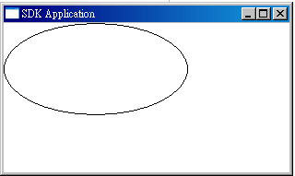
Result

Slide 20
Method 2 - Application Frameworks
Application Frameworks（AF, 應用軟體架構）
  Build the basic framework of a Window application program

Slide 21
Method 2 - Application Frameworks
Application frameworks
  Object-oriented
  Inheritance
    Inherit Menu class
  Composition:
    Use Button class
AF
  Microsoft MFC, .NET Framework base classes, WPF
  Sun Java API, Borland OWL

Slide 22
Reviews
What is Window Application Frameworks? Give some examples of Window Application Frameworks.
What kinds of methods can write Window application programs?

Slide 23
Window Programming 1-1
Visual Studio.NET

Slide 24
Integrated Development Environment -Visual Studio .NET
Visual Studio .NET
  Integrated Development Environment, IDE
Version
  Visual Studio.NET 2002
  Visual Studio.NET 2003
  Visual Studio 2005
  Visual Studio 2008
  Visual Studio 2010
  Visual Studio 2012
  Visual Studio 2013
  Visual Studio 2015
  Visual Studio 2017
  Visual Studio 2019
  Visual Studio 2022

Slide 25
Visual Studio .NET
Win 32 API
MFC (Microsoft Foundation Class)
.NET Framework base classes

Slide 26
Languages in Visual Studio.NET
Visual Basic.NET
Visual C++.NET
Visual C#.NET
Visual J#.NET (Visual Studio 2005)

Slide 27
Languages in Visual Studio.NET
Visual Basic.NET
  Managed, intermediate form, Window Form (.NET)
Visual C++.NET
  Managed, intermediate form, Window Form (.NET)
  Machine code ：Win32, MFC
Visual C#.NET
  Managed, intermediate form, Window Form (.NET)
Visual J#.NET (2005)
  Managed, intermediate form, Window Form (.NET)

Slide 28
Languages in Visual Studio.NET
Visual C++.NET
  Managed, intermediate form, Window Form (.NET)
    Design GUI, write message handler functions
  Machine code：Win32, MFC
    Design and write classes, resources, message handlers

Slide 29
Machine code
Programmers
Write the programs
MFC programs
Compile
Machine code
Release

Slide 30
Machine code
Program users
Execute the program
Machine code
Execution

Slide 31
Window Form.NET
Programmers
Write the program
Window Form.NET program
Virtual machine
Intermediate Language code
Release

Slide 32
Window Form.NET
Program users
Execute the program
Intermediate language code
Virtual machine JIT (Just-In-Time)
Machine code
Execution

Slide 33
.NET Framework
Internet Server
(網站服務)
Internet User
(使用者的瀏覽器製作網頁)
本機使用者
(一般應用程式)
ASP.NET
XML網站服務
Web平台
Windows平台
.NET Framework base classes (基底類別)
(ADO.NET功能、XML功能、網路功能、安全性功能等等)
.NET
Framework
共通語言執行期間程式庫(CLR: Common Language Runtime)
Window Operating System

Slide 34
.NET Framework
.NET Framework: cross language
Visual Basic.NET
Visual C++.NET
Visual C#.NET
共通語言執行期間程式庫(CLR: Common Language Runtime)
Windows operating system

Slide 35
Java
Java: cross OS
Java
Java Virtual Machine
Windows OS
Mac OS
Unix OS

Slide 36
Reviews
Which kinds of languages are provided in Visual Studio .NET?
What is intermediate language code? What is machine code?
Please compare the operation of intermediate language in Java and .NET Framework.

Slide 37
Window Programming 1-1
Write a Windows Form program using Visual Studio C#

Slide 38
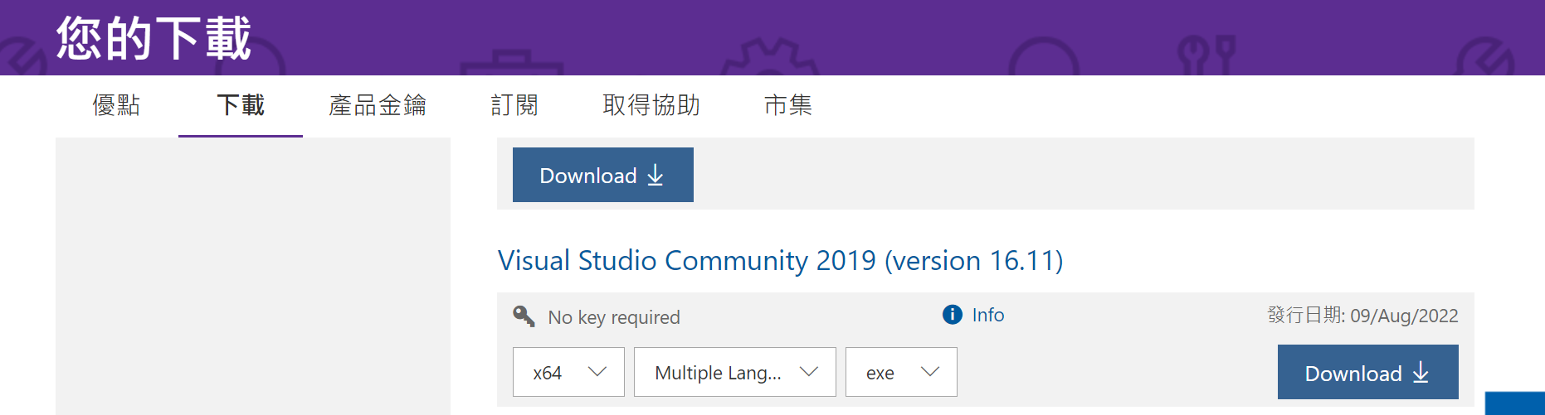
Visual Studio Community 2019
https://visualstudio.microsoft.com/zh-hant/vs/older-downloads/
Free for personal, education, academy

Slide 39
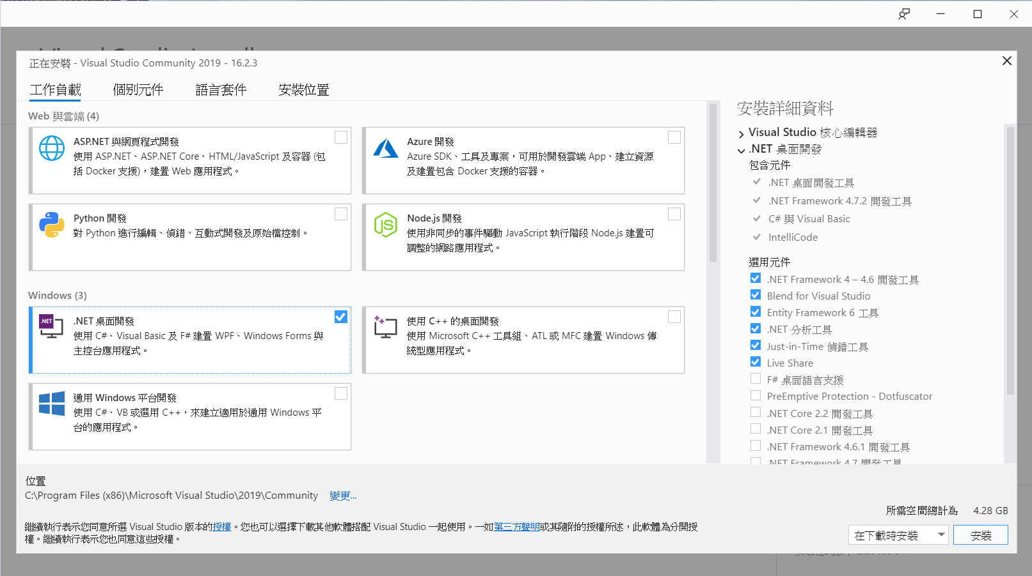
Install Visual Studio Community 2019
1. Include .NET桌面開發
2. Install

Slide 40
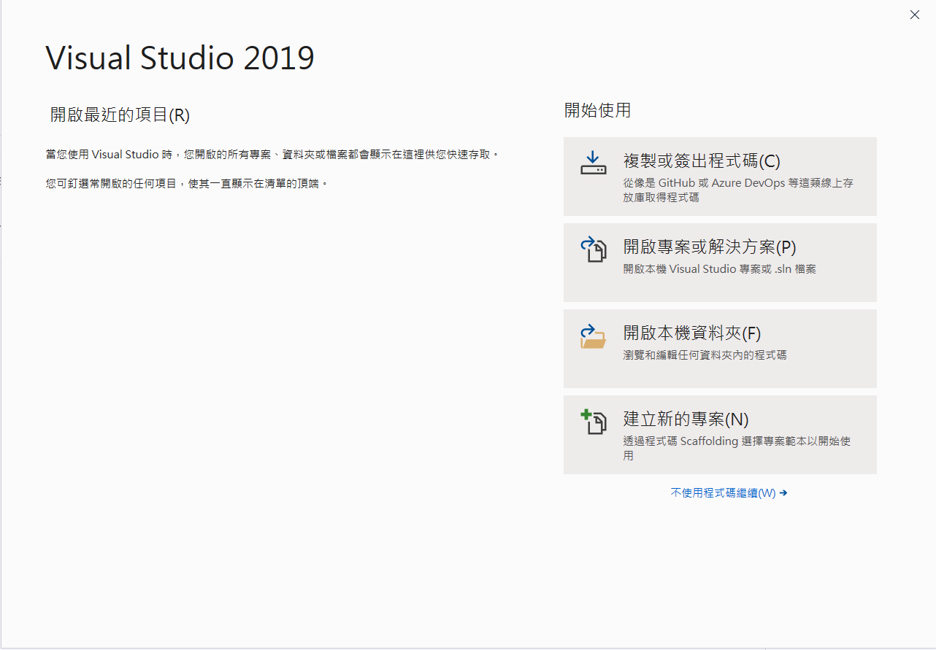
Create a Windows Form Application
Create new project

Slide 41
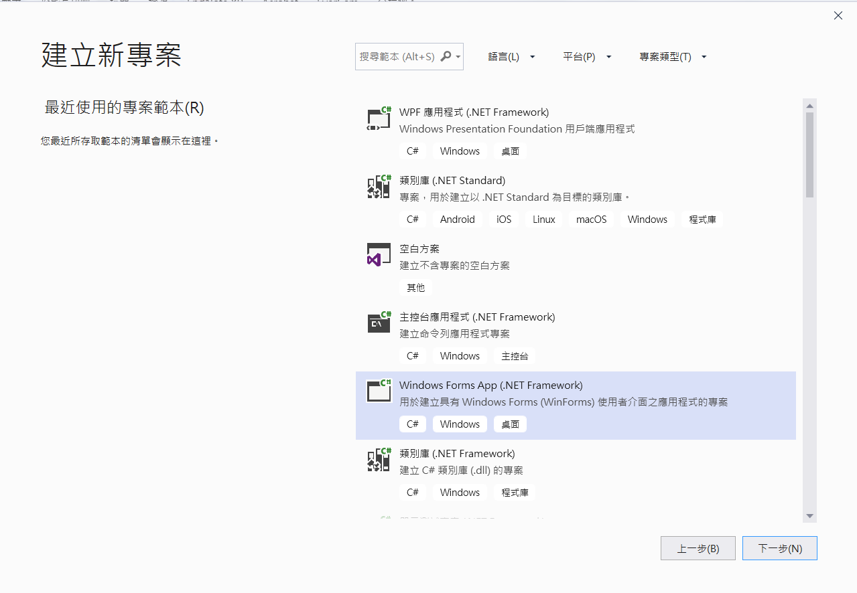
Create a Windows Form Application
1. Choose Windows Forms App (.NET Framework) C#
2. Next

Slide 42
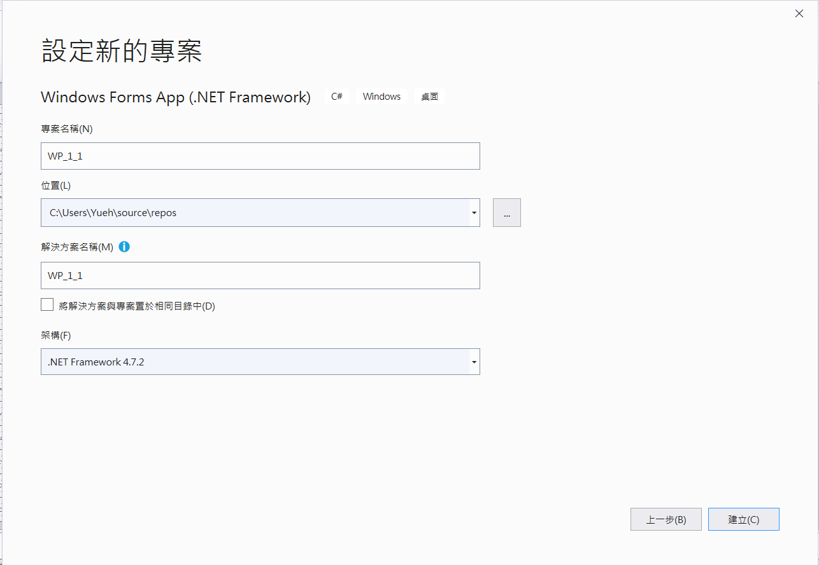
Create a Windows Form Application
1. Modify the project name
2. Choose the project location
3. Create

Slide 43
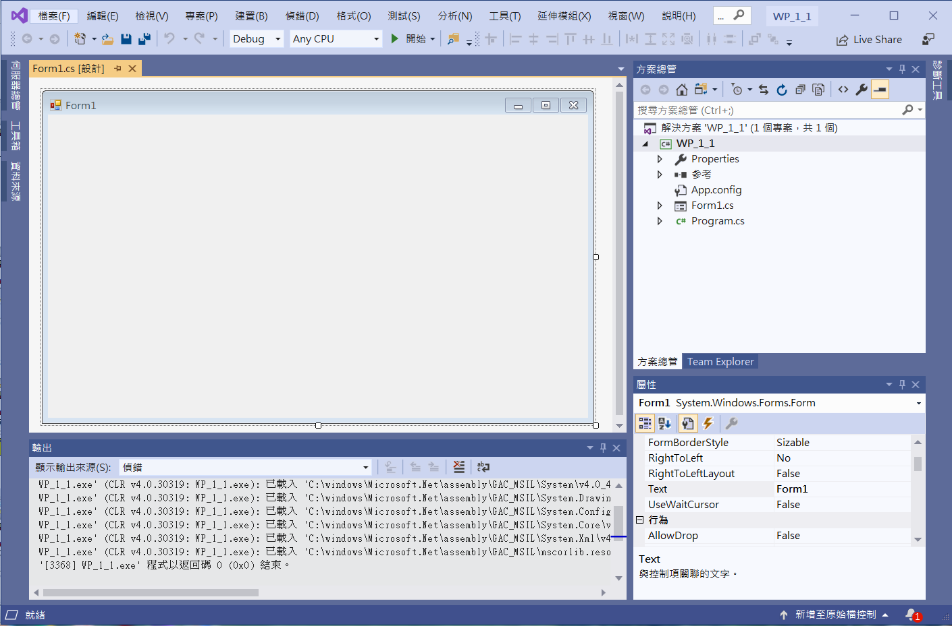
Create a Windows Form Application
Compile & Run
Form
Attributes of the form

Slide 44
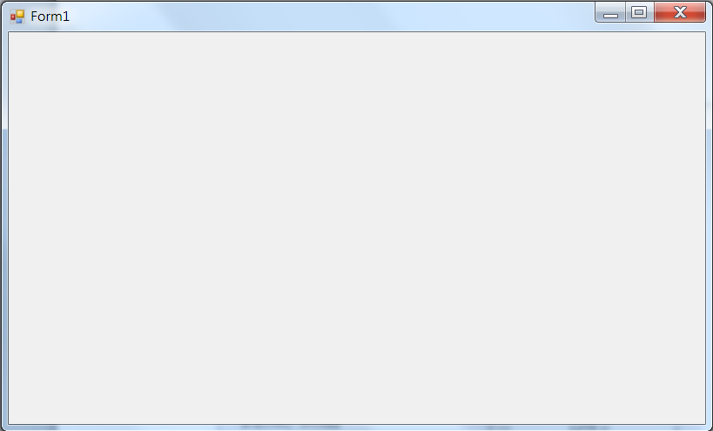
Create a Windows Form Application

Slide 45
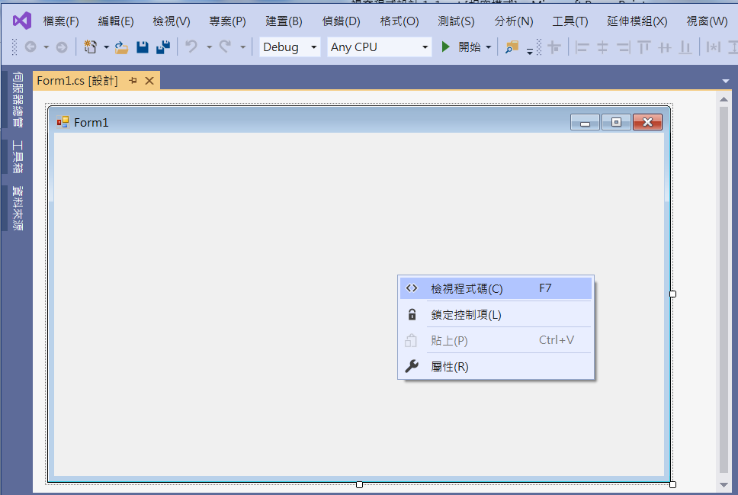
Create a Windows Form Application
1. Click at right button inside the form
2. View code

Slide 46
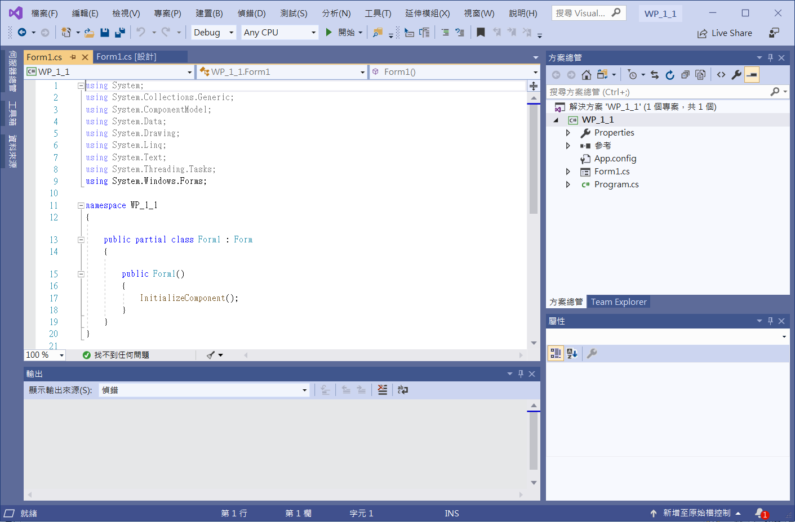
Create a Windows Form Application

Slide 47
Terms
Form(表單)
Name(名稱)
Component(控制項)

Slide 48
Use object attribute browser to set up attributes

Slide 49
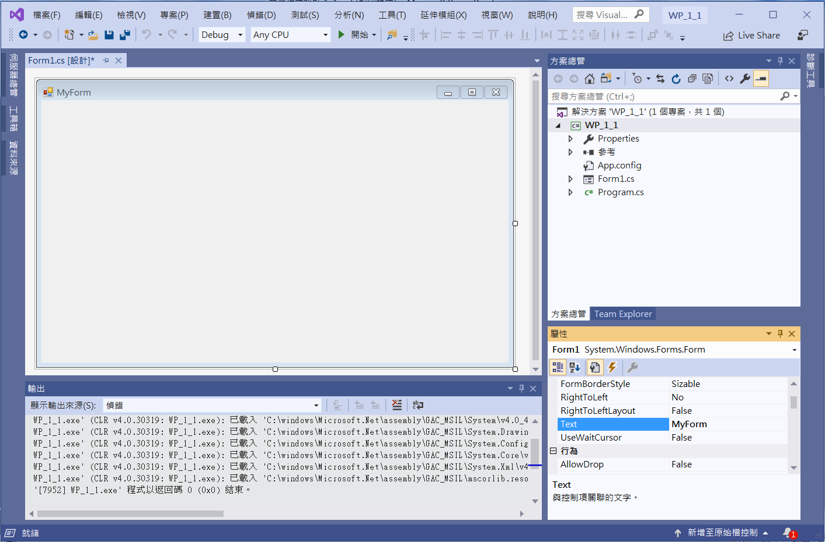
Common attributes of Form object
Text
Title of Form
Edit Text to change the title of Form

Slide 50
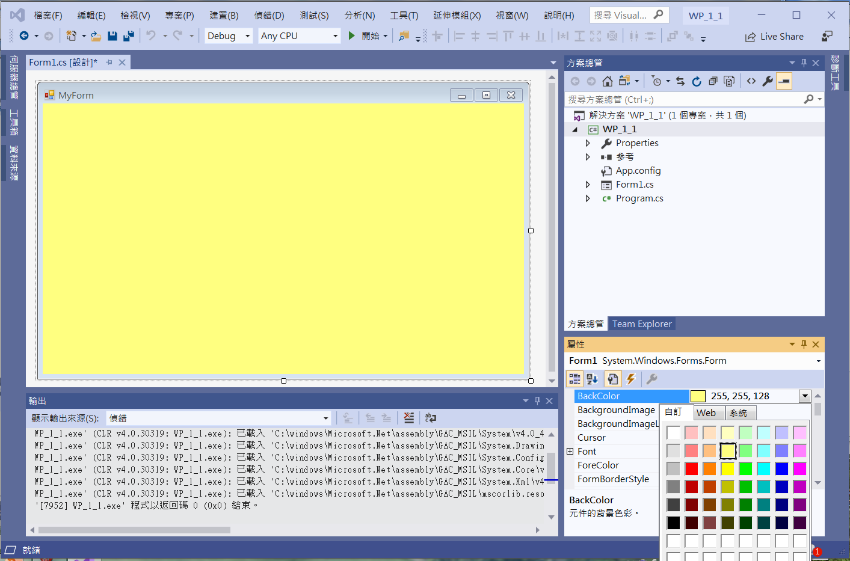
Common attributes of Form object
BackColor
Background color

Slide 51
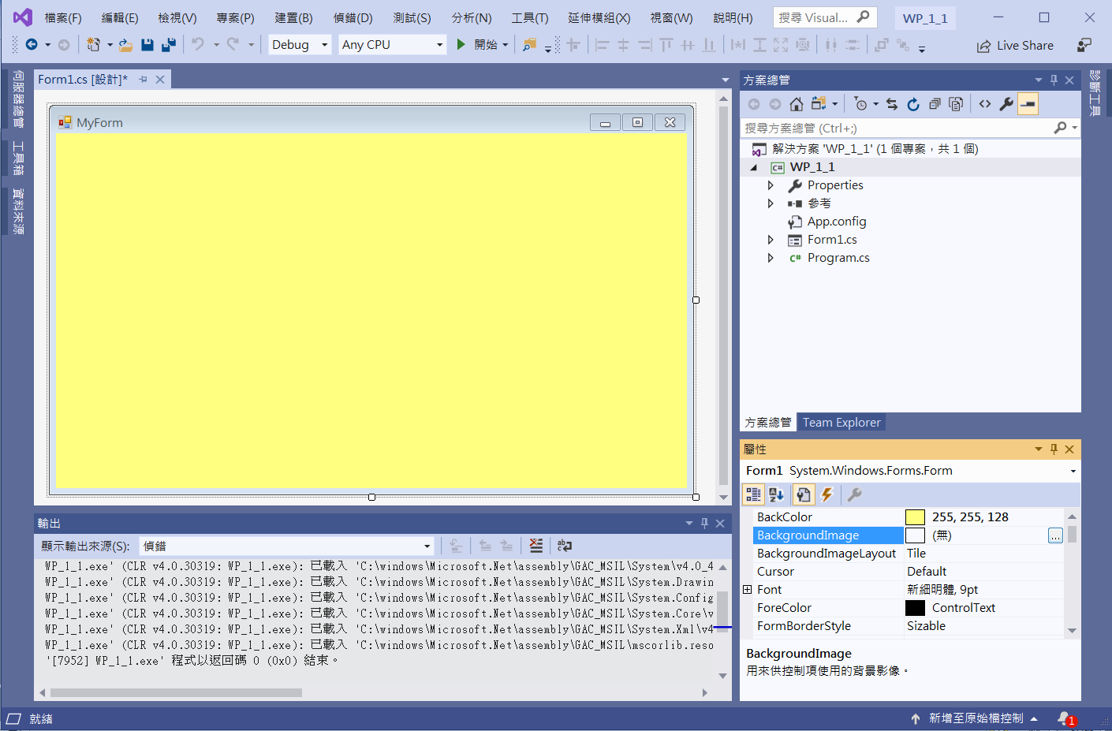
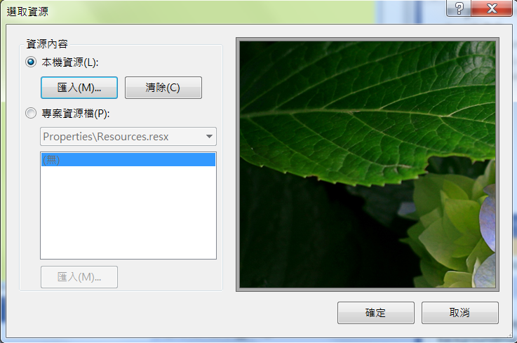
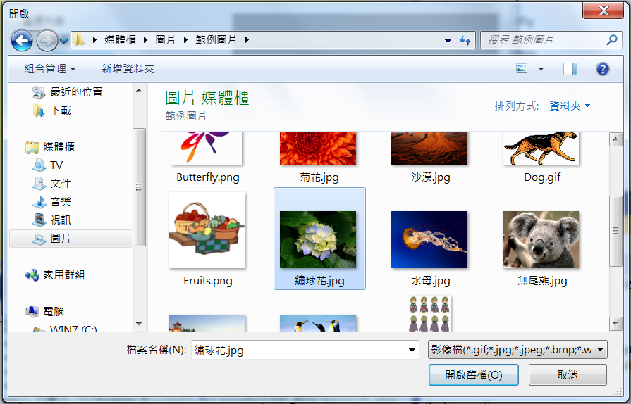
Common attributes of Form object
BackgroundImage
2. Import file
1. Choose file for Background image
3. Choose a image file

Slide 52
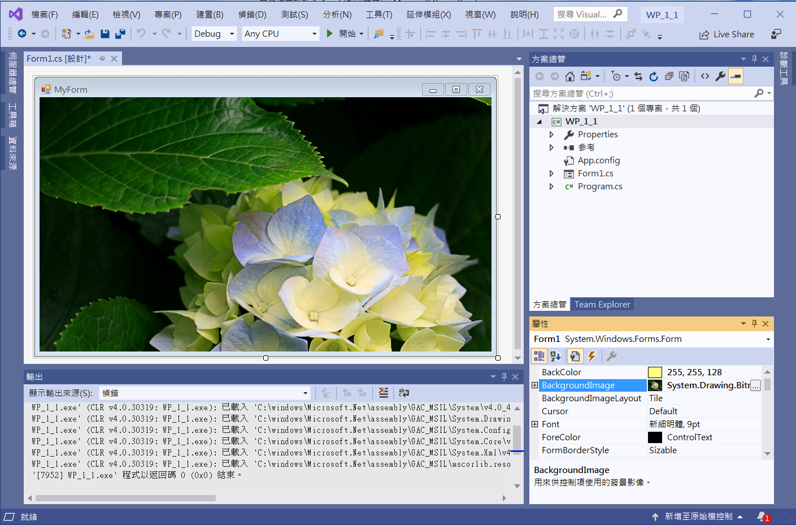
Common attributes of Form object
BackgroundImage

Slide 53
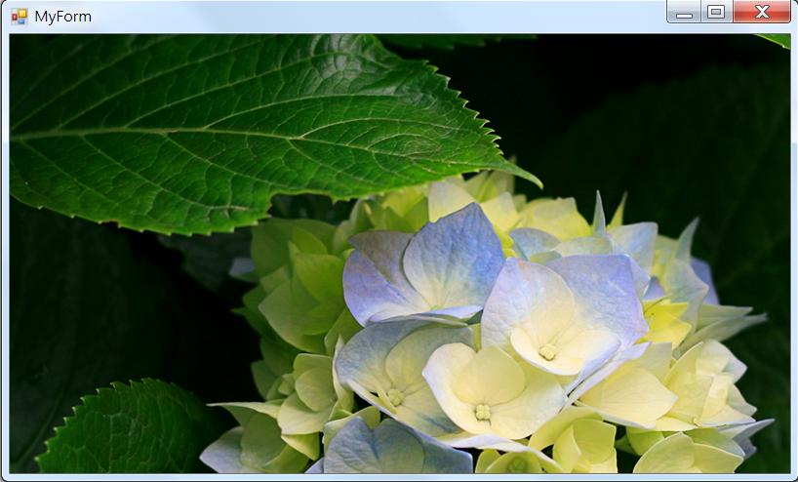
Exercise#1-1

